Slide 1
NTFS
Created by: Hamzeh AlRishiq
Edited by Safaa Hriez with the aid of Dr. Ali’s slides

Slide 2
What is NTFS?

Slide 3
NTFS (New Technology File System)
It is a proprietary file system developed by Microsoft.
Windows File System.
Was first introduced in Windows NT.
NTFS has been found to overcome FAT disk size limitation, length of name, and disk space utilization.

Slide 4
Why NTFS?

Slide 5
NTFS Features
Large Volume Support: NTFS supports very large volume sizes (up to 256 terabytes).
Fault Tolerance: NTFS maintains redundant copies of critical file system metadata, such as the Master File Table (MFT).
File Compression.
NTFS supports long file names of up to 255 characters.
Reliability:
Journaling. (Recording changes to the file system before applying them to the disk. This means that actions such as creating, modifying, or deleting files and directories are first logged or journaled before being executed on the disk).
CRC bytes everywhere.

Slide 6
NTFS Features (continued)
Advance Security Features such as:
EFS (Encrypting File System).
Logging File System.
Specified Permissions for Each File.

Slide 7
NTFS Features (continued)
Data Deduplication: NTFS includes data deduplication capabilities to reduce storage space usage by identifying and eliminating duplicate data across files and volumes.
Sparse Files:
A file is considered to be sparse when much of its data is zero (empty data).
Instead of storing every zero byte individually, sparse file systems store information about these zero-filled regions without allocating actual disk space for them. This approach conserves disk space and improves storage efficiency.
Notes:
In a sparse file, only non-zero data is allocated physical storage space on the disk. When reading a sparse file, the file system recognizes the sparse regions and fills them with zeros as needed, providing the illusion of a fully populated file to applications. However, in reality, the sparse regions consume minimal disk space, equivalent to metadata describing their size and position within the file.
Sparse files are commonly used in scenarios where files contain large amounts of empty space, such as virtual machine disk images, database files, or log files. By using sparse files, storage resources can be utilized more efficiently, reducing disk space consumption and improving overall system performance.

Slide 8
NTFS Structure

Slide 9


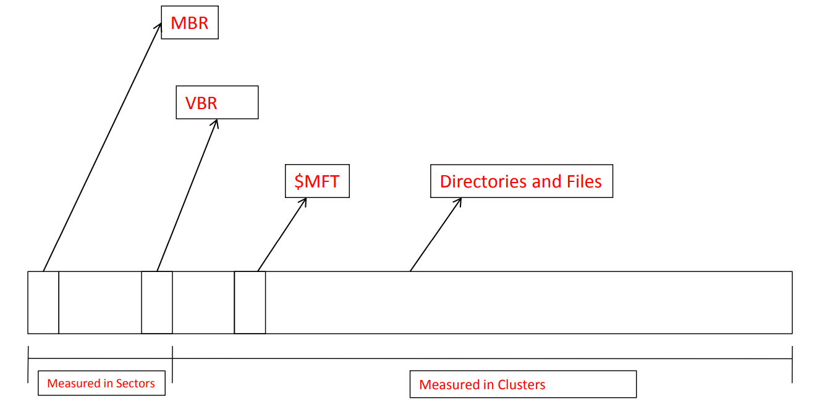

NTFS partition

Slide 10
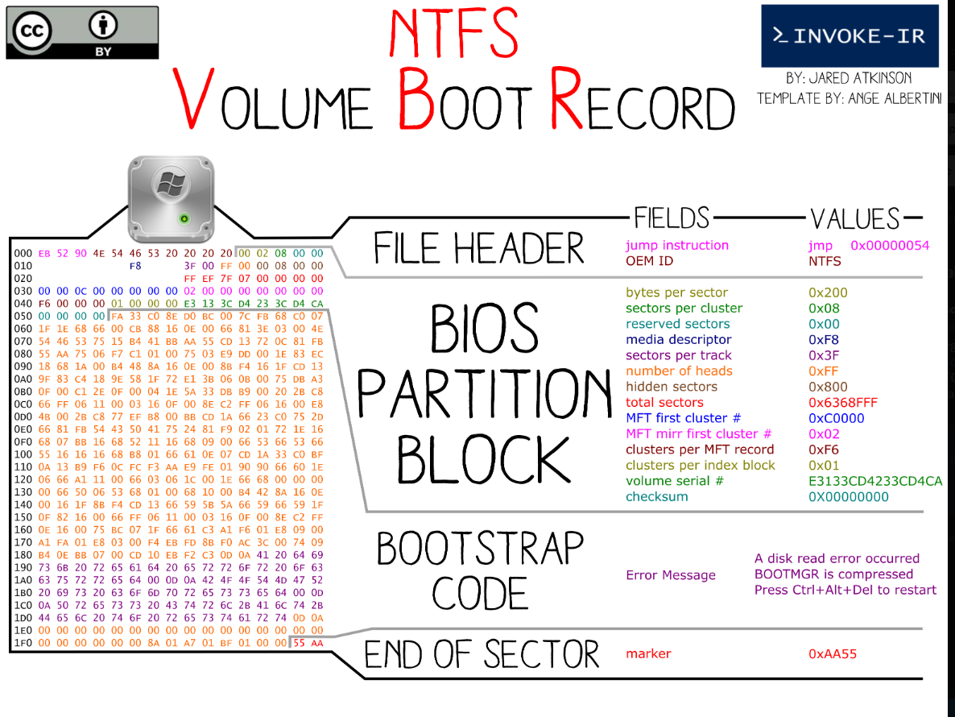

Slide 11
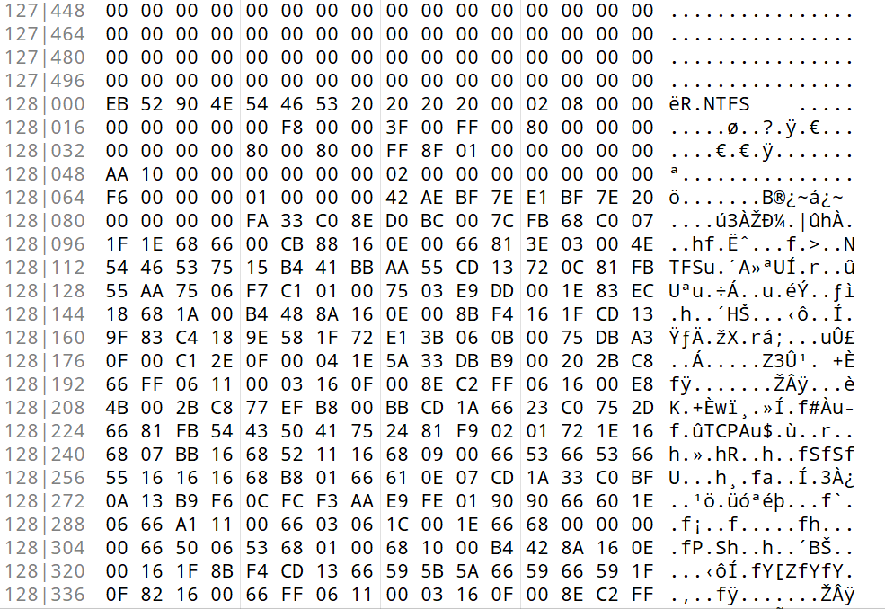
Jump Instruction
OEM ID
Bytes Per Sector
Sectors Per Cluster
Reserved Sectors
Always Zero
$MFT LCN
Unused
$MFTMirr LCN
Media Descriptor
Clusters Per File Record Segment
Always Zero
Sectors Per Track
Clusters Per Index Buffer
Number of Heads
Volume Serial Number
Hidden Sectors
Unused
Checksum
Signature but not used by NTFS
From FA 33 bytes to 55 AA (end of sector) are the Bootstrap Code
Total Sectors

Slide 12
Media Descriptor
The media descriptor byte is a single byte field that provides information about the storage media on which the partition resides. The media descriptor byte is located at offset 0x15 (decimal 21) within the VBR.
Possible values:
0xF8: Indicates that the media is a fixed disk. This value is commonly used for hard drives and solid-state drives (SSDs).
0xF0: Represents a removable media device, such as a floppy disk or a USB flash drive.

Slide 13
MFT File Structure

Slide 14
Master File Table (MFT)
The MFT is an array of file records
Each record is 1024 bytes
Records in the MFT are called metadata
The first record in the MFT is for the MFT itself
The name of the MFT is $MFT
The first 16 records in the MFT are reserved for metadata files
It reserves 12.5% of the disk space.

Slide 15
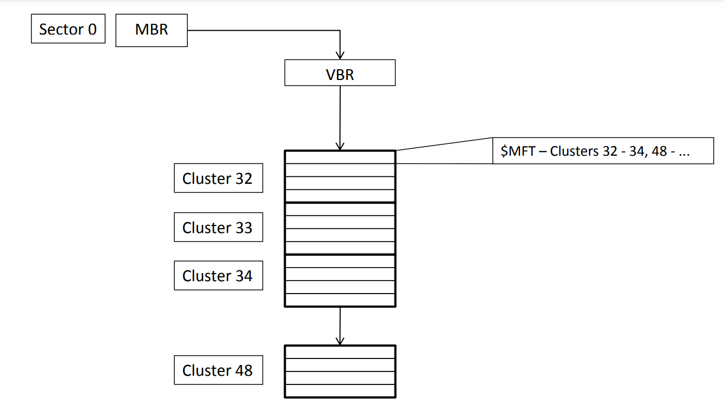
MFT (continued)

Slide 16
MFT (continued)
0 | $MFT
1 | $MFTMirror
2 | $logfile
… | …
10200 | File1.txt
… | …

Slide 17
MFT (continued)
Each MFT entry is 1024 bytes and consists of:
Entry header
Attributes
Each attribute consists of:
Attribute header
Attribute data
Attributes are free form
Fixed list of attributes

Slide 18
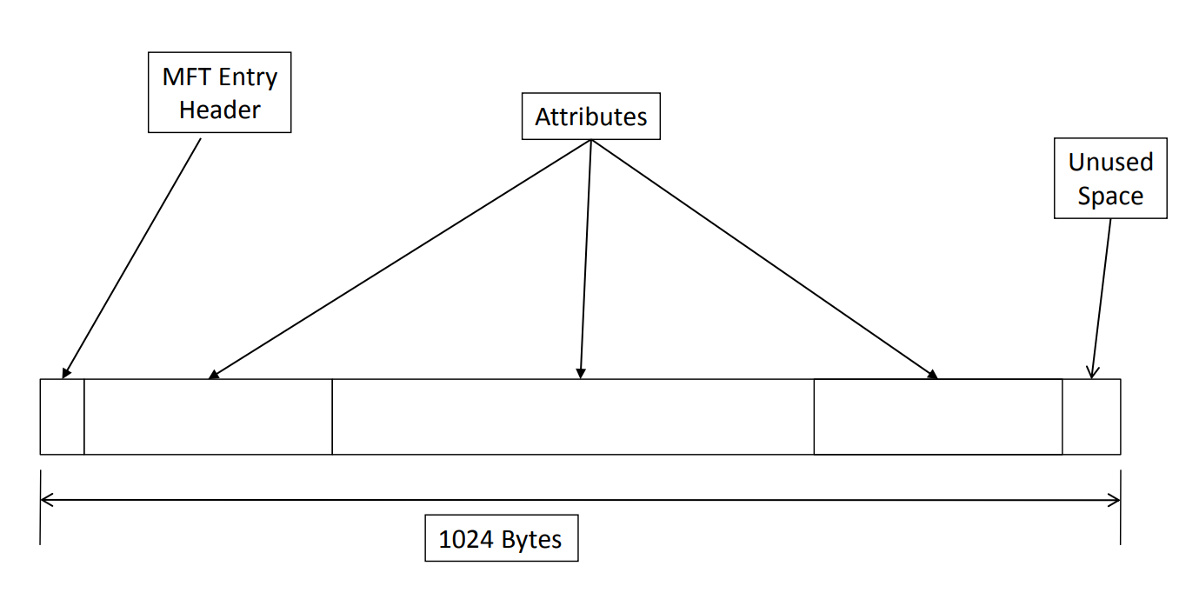
MFT entry format

Slide 19
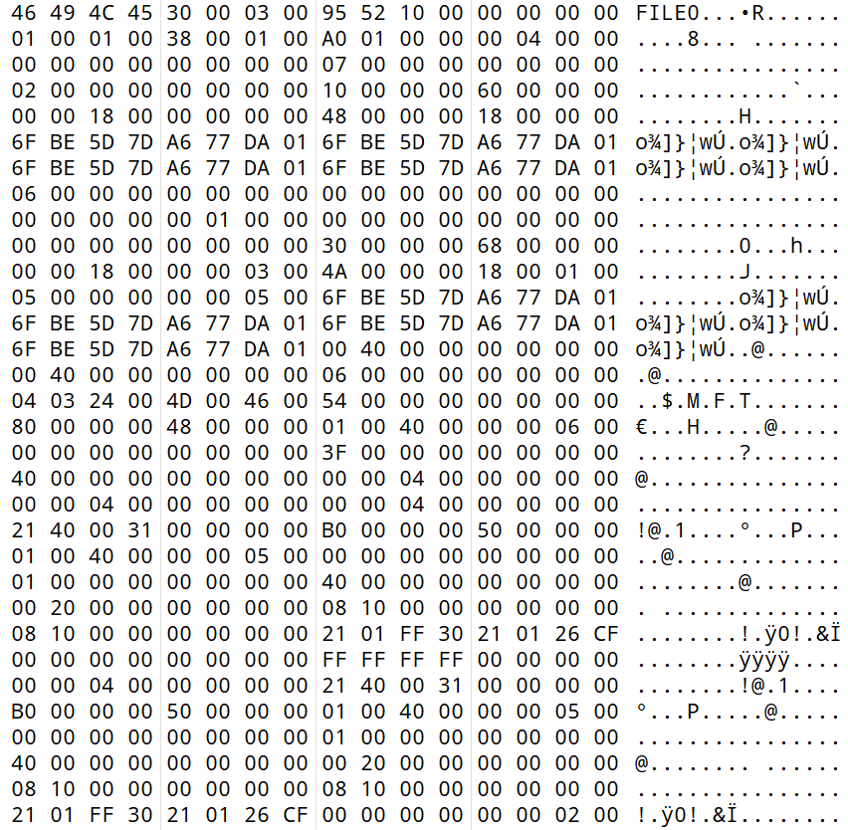
MFT File Signature
MFT Header
Standard Information Attribute
File Name Attribute
Data Attribute
End Of Attributes
Bitmap Attribute
End Of Sector
Notes:
The Master File Table (MFT) in NTFS (New Technology File System) serves as a crucial component for organizing and managing files on a disk. Each file and directory in an NTFS volume is represented by a record in the MFT. These records, often referred to as MFT entries, contain metadata and pointers to the actual data of the file or directory.
When a file is created, modified, or deleted, the corresponding MFT entry is updated to reflect these changes. The MFT plays a central role in file system operations, facilitating efficient file access, metadata management, and disk space allocation within the NTFS file system.

Slide 20
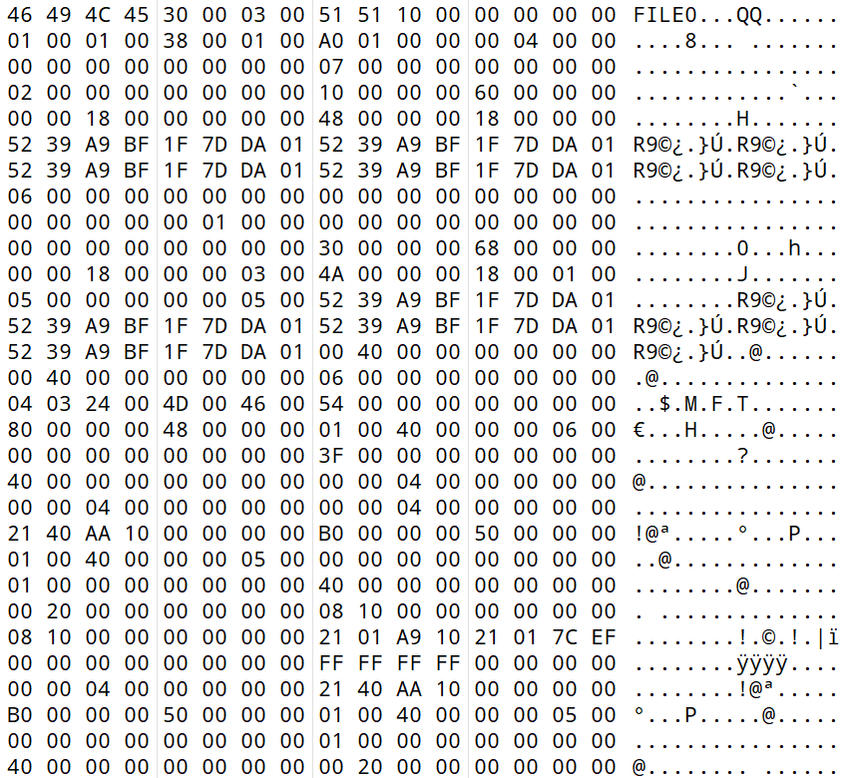
MFT File Signature
MFT Entry Header Structure
Record Status Flag
Offset to Fixup Array
Allocated size of MFT Record
Number of Entries in Fixup Array
Actual Size of MFT Record in Bytes
File reference to base MFT Record
Log File Sequence Number
Next Attribute ID
Sequence Number
MFT identification Number
Hard Link Count
Offset to the first Attribute
Update Sequence Number
Update Sequence Array

Slide 21
MFT file signature
The file records within the MFT have a signature at their beginning to identify them as MFT records. This signature is a four-byte sequence typically has two values "FILE“ or “BAAD”.

Slide 22
Notes About MFT Header
The "Offset to Fixup Array" points to where the "Update Sequence Number" bytes begin. (Remember, your starting point is the MFT signature).
The “Number of Entries in Fixup Array” is length of update sequence.
The "Sequence Number“ is a value associated with each record in MFT of an NTFS file system. Its primary job is to track the number of times a particular MFT record has been used or accessed.
“Allocated size of MFT Record” also known as physical size MFT record.
“Actual Size of MFT Record in Bytes” also known as logical size MFT record

Slide 23
Record Status Flag
Flag Value | Description
00 00 | Deleted File Record
01 00 | File Record in Use
02 00 | Deleted Directory Record
03 00 | Directory Record in Use

Slide 24
USA and USNs
The Update Sequence Array (USA) and Update Sequence Numbers (USNs) are essential components of the NTFS file system. They work together to track changes made to MFT. When modifications occur, the USA records where changes are made within the MFT, while USNs serve as markers for these modifications. This tracking mechanism ensures data integrity by allowing the file system to detect and address any potential corruption, thereby maintaining the reliability of the MFT and the files it contains.

Slide 25
MFT Identification Number
The MFT Identification Number is a crucial component of the NTFS file system, providing a unique identifier for each file and directory entry, facilitating efficient file system operations, and aiding in file recovery efforts when needed.
Each file, directory, or other file system object within an NTFS volume is represented by a record in the MFT, and each record is assigned a unique MFT Identification Number. This number serves as a reference or key to locate and manage the associated file or directory on the disk

Slide 26
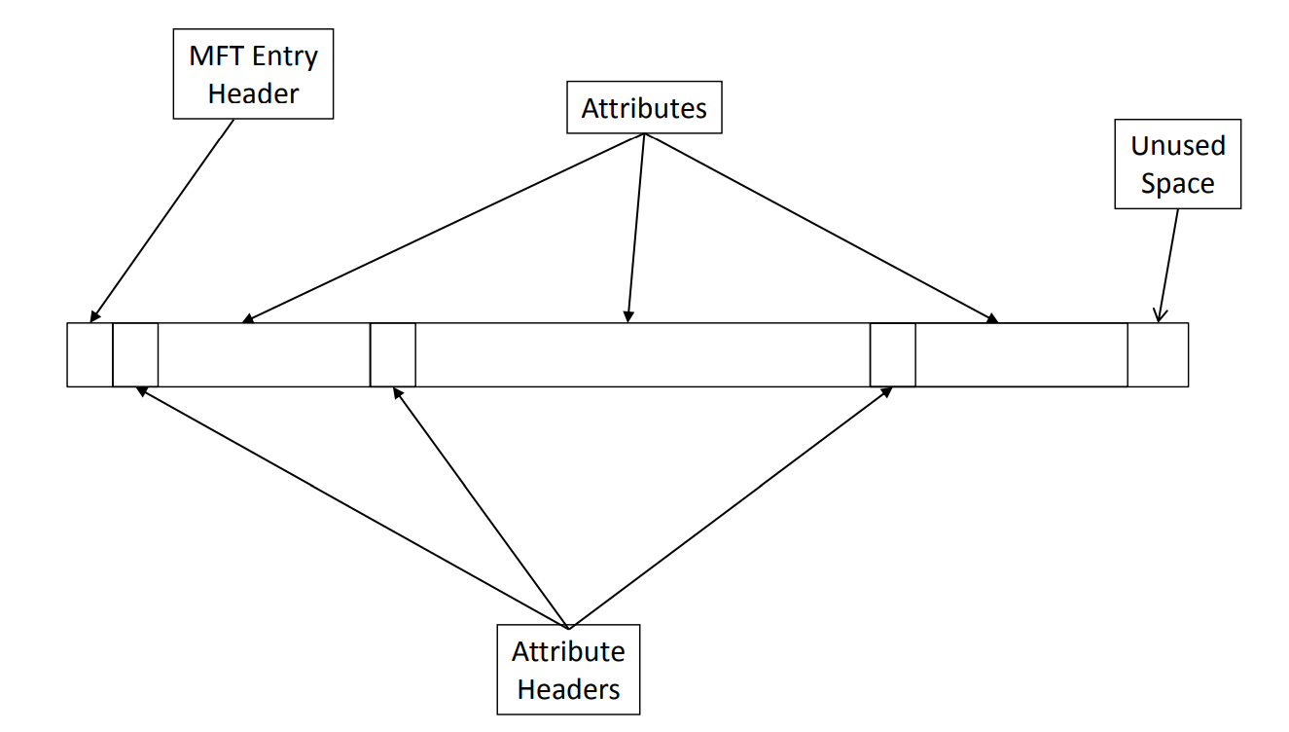
MFT record structure

Slide 27
Most common and important MFT Attributes
Attribute Signature | Attribute Name | Description
10 00 00 00 | Standard_Information | Contains basic metadata for the file or directory
20 00 00 00 | Attribute_List | Location of other attributes
30 00 00 00 | File_Name | File’s name and parent OR directory index
40 00 00 00 | Object_ID | Global object identifier
80 00 00 00 | Data | Raw content
B0 00 00 00 | Bitmap | Bitmap for the MFT file and for indexes

Slide 28
Important Notes About Attributes
Each attribute begins with a header containing essential information about the attribute.
The attribute header is followed by a signature, which identifies the type of attribute.
After the header and signature, the attribute contains specific data or content. This content varies depending on the attribute type and may include file metadata, data streams, security descriptors, or other information.

Slide 29
Important Notes About Attributes Header (continued)
When determining the position of the first byte of attribute content using the Offset of Attribute Content specified in the header, remember that the starting point for counting is the first byte in the attribute signature.
The header named Size of Attribute Content represents the attribute size minus the size of the attribute header.
All the attributes have the same generic header structure.

Slide 30
Resident Attribute Header Structure
Attribute Signature
Attribute ID
Size of content
Attribute Size
Offset Of Attribute Content
Residency Flag
Length of Attribute Name
Index Flag
Offset Name Field
Padding
Attribute Content
Status Flag

Slide 31
Residency
Attributes can be resident, meaning they fit entirely within the MFT record (MFT record size is 1024 bytes), or non-resident means the content is stored elsewhere on the disk.
Resident attributes are typically smaller and contained entirely within the MFT record, while non-resident attributes may require additional disk space to store their data.
In summary:
Resident (0) – The content of the attribute is contained in the MFT entry
Non-resident (1) – The content of the attribute is contained in clusters not in the MFT entry

Slide 32



Important Notes About Attributes Header
Flag Value | Description
00 00 | Normal attribute
00 01 | Compressed attribute
40 00 | Encrypted attribute
80 00 | Sparse attribute
Status flag is used to indicate the current status of the attribute:

Slide 33
How to locate the attributes in MFT record
Find the Offset to the First Attribute:
Look for the offset value that indicates the position of the first attribute. This offset is typically specified in the MFT header.
Calculate the Position of the Next Attribute:
Once you have the offset to the first attribute, add it to the size of the first attribute to find the position of the second attribute.
To find subsequent attributes, keep adding the size of each attribute to the position of the previous attribute.
Continue calculating the positions of attributes until you find one where the next attribute's offset value is “FF FF FF FF”.

Slide 34
How to locate the attributes in MFT record (continued)
Important Notes:
Starting Point for Attributes:
Begin counting from the position of the MFT signature in the file.
The offset to the first attribute is determined from this starting point.
Identifying the Last Attribute:
Look for the value 0xFFFFFFFF to indicate the end of attributes in the MFT record. When you encounter this value as the offset for the next attribute, you know you've reached the last attribute in the record.

Slide 35
$Standard_Information Attribute

Slide 36
$Standard_Information Attribute (continued)
Type Identifier – 16 (0x10)
Times are in 100-nanoseconds from 1/1/1601
Same time fields are in the $FILE_NAME attribute
These are shown in file properties

Slide 37
$Standard_Information Attribute Content Structure
Attribute Header
Maximum Version Number
File Created Time Stamp
Version Number
File Modified Time Stamp
Class ID
Owner ID
MFT Modification Time
Security ID
Quota Charged
File Accessed Time
Update Sequence Number
Flag
* Time are in UTC time and has to be converted to a specific time with taking into consideration the daylight saving

Slide 38
$Standard_Information Attribute Content Structure (continued)
Flag | Description
00 01 | Read only.
00 02 | Hidden.
00 04 | System.
00 20 | Archive.
00 40 | Device.
00 80 | Normal.
01 00 | Temporary.
02 00 | Sparse File.
Flag | Description
04 00 | Reparse Point.
08 00 | Compressed.
10 00 | Offline.
20 00 | No Content Indexed.
40 00 | Encrypted.

Slide 39
$Standard_Information Attribute Content Structure
The Security ID bytes is an index into the file $Secure. This index allows the operating system to access and retrieve the security descriptors associated with the file or directory. The $Secure file contains detailed information about security settings and permissions assigned to files and directories on the disk.

Slide 40
$File_Name Attribute

Slide 41
$File_Name attribute
Type Identifier – 48 (0x30)
Stores the file’s name
Parent directory
Directory index
For standard files or directories $FILE_NAME is the second attribute and is resident
If a file requires multiple MFT entries the $ATTRIBUTE_LIST occurs second

Slide 42
$File_Name Attribute Content Structure
Attribute Header
Allocated Size of File
Parent Directory
Actual Size of File
File Creation Time
Flags (same as $standard_information flags)
File Modification Time
MFT Modification Time
Reparse Value
Length Of Name
File Accessed Time
Namespace
Name
* Time are in UTC time and has to be converted to a specific time with taking into consideration the daylight saving

Slide 43
$File_Name namespace value
0: Posix: Case sensitive, all Unicode characters except ‘/’ and NULL
1: Win32: Case sensitive, all Unicode characters except ‘/’, ‘\’, ‘:’, ‘’, and ‘?’ 2 DOS: Case insensitive, upper case and no special characters
3: Win32 & DOS: Used when the original name already fits in the DOS namespace and two names are not needed

Slide 44
Timestamps
Creation Time (or Born Time): This timestamp indicates the date and time when the file or directory was initially created.
Modified Time (or Last Modified Time): This timestamp reflects the last modification or change made to the file's content or directory's attributes.
Access Time (or Last Access Time): This timestamp indicates the last time the file or directory was accessed or opened.
MFT modification Time (Metadata Change Time or Change Time): This timestamp represents the time when the file's metadata (such as file permissions or attributes) was last modified.

Slide 45
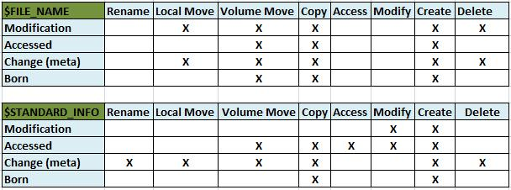
Timestamps
**Change (meta): MFT modification time **Born: File creation time
https://www.sans.org/blog/digital-forensics-detecting-time-stamp-manipulation/

Slide 46
Timestomp
Timestomp is a term used to describe the act of modifying or altering the timestamps associated with files or directories on a computer system. It involves changing the values of the creation time, modified time, access time, or other related timestamps.
Timestomping is often employed as a technique to manipulate or hide information about file activity or tampering. By modifying the timestamps, an attacker or unauthorized user can attempt to conceal their actions, make files appear older or newer than they actually are, or manipulate the sequence of events related to file access or modification.

Slide 47
$Data attribute

Slide 48
$Data attribute (continued)
Type ID – 128 (0x80)
Still has the generic attribute header fields
The first $DATA attribute does not have a name
Additional $DATA attributes can be used for Alternate Data Streams and as such each must have a name.
C:\> echo “Hello world” > file.txt:hidden.txt
If the contents > 700 bytes it goes non-resident
Directories can have $DATA attributes

Slide 49
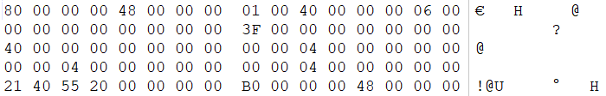
Non-resident Attribute Structure
Attribute Signature
Offset to runlist
Compression unit size
Attribute Size
Residency Flag
Unused
Length of Attribute Name
Allocated size of attribute content
Actual size of attribute content
Offset Name Field
Initialized size of attribute content
Status Flag
Attribute ID
Runlist
Starting VCN
Ending VCN

Slide 50
VCN vs LCN
VCN – Virtual Cluster Number:
1st, 2nd, etc cluster of the file/attribute regardless of where it is in the file system
LCN – Logical Cluster Number:
Cluster number relative to the first cluster after the VBR

Slide 51
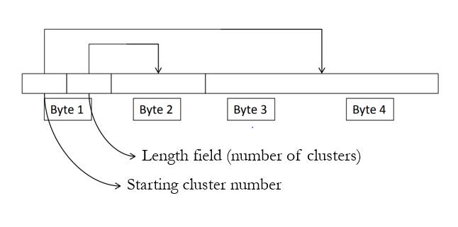
Runlist
Offset to the runlist is relative to the start of attribute
The run list is a sequence of cluster runs that contain the data for this file

Slide 52
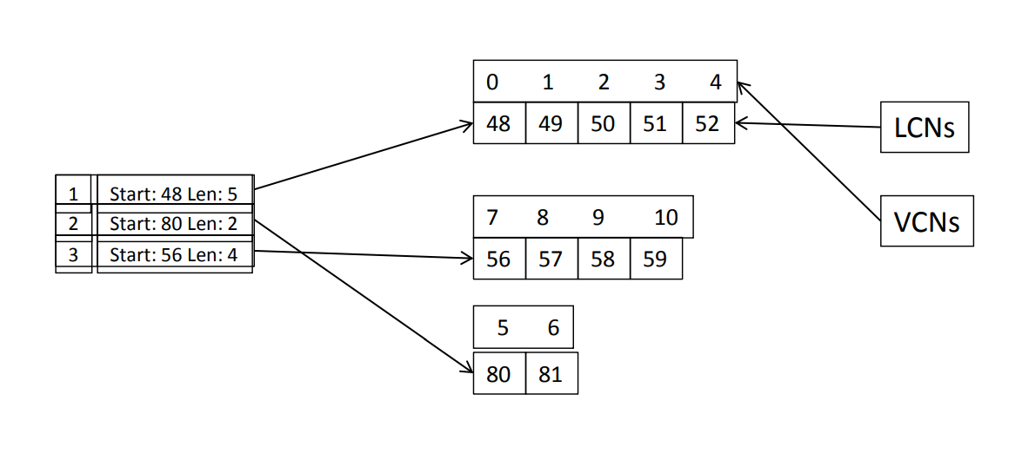
Runlist example

Slide 53
Runlist example
21 01 90 0F 21 05 8E 2A

Slide 54
Runlist example
21 01 90 0F 21 05 8E 2A
Run1: 21 01 90
2 = 90 0F (first cluster #) = 0F90 = 3984
1 = 01 (length) = 1 cluster
Run2: 21 0f 8E 2A
2 = 2A 8E = 10894 (relative offset to the first cluster #)
= 10894 + 3984
= 14878 (which is the second cluster in this file)
1 = o5 (length) = 5 clusters (means I have 5 clusters here)

Slide 55
Runlist example
21 01 90 0F 21 05 8E 2A
Run1: 21 01 90
2 = 90 0F (first cluster #) = 0F90 = 3984
1 = 01 (length) = 1 cluster
Run2: 21 0f 8E 2A
2 = 2A 8E = 10894 (relative offset to the first cluster #)
= 10894 + 3984
= 14878 (which is the second cluster in this file)
1 = o5 (length) = 5 clusters (means I have 5 clusters here)
How many clusters in total? = 6
Cluster numbers for this file = 3984, 14878, 14879, 14880, 14881, 14882

Slide 56
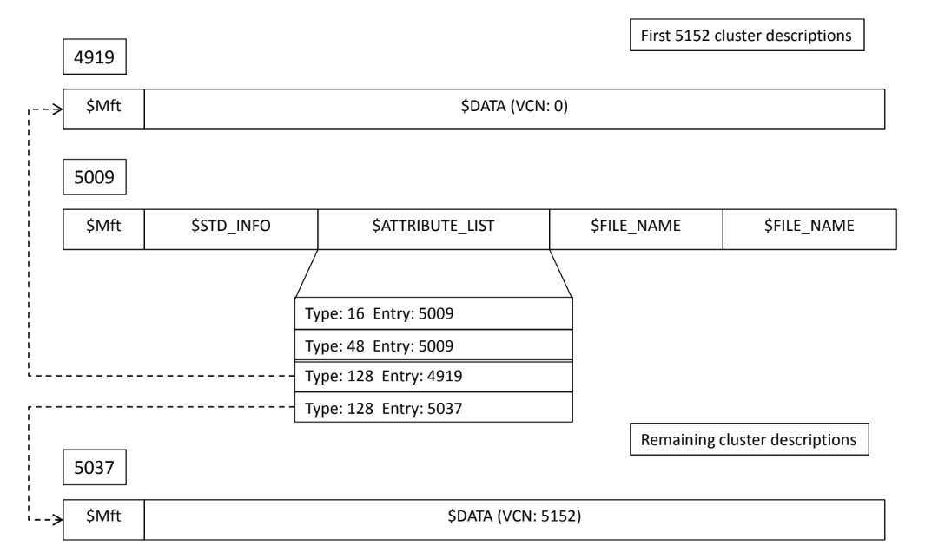
$Attribute_list

Slide 57
MFT Browser
https://github.com/kacos2000/MFT_Browser/releases

Slide 58
Practical
Create a file with small size.
Check an MFT record for the file.
Resize the file.
Check its entry again. Talk about MFT slack.
Create another file, then resize the original file to be fragmented.

Slide 59
Metadata files

Slide 60
Metadata files
The metadata files in NTFS contain information used to implement the file system structure.
Their names begin with $
The $ is usually hidden
MFT entries from 0 – 15 are reserved for metadata files
All the rest of the MFT entries are for normal files and directories

Slide 61
Important metadata files within NTFS
File Name | Description
$MFT | The main file in NTFS volume which contains all the details of every file on the volume including the file management that are used for filling the system. MFT take within 12.5% of NTFS volume size.
$MFTMirr | It’s a duplicate file from MFT.
$LogFile | It records the transactions to and from drive
$Volume | It contains important data about the volume such as volume label, amd the NTFS version, the creation time and date.
$Bitmap | It's a map used to identify the clusters that are in use and those that are not. '1' symbolizes an in-use cluster, while '0' symbolizes that a cluster is not in use.
$AttrDef | This contains a table of attribute names, allocated identifier numbers, and descriptions.
Notes:
The dollar symbol means that this file is system file as use cannot see it or view it.

Slide 62
Important metadata files within NTFS (continued)
File Name | Description
$Boot | This file serves as the foundation for initializing the NTFS file system and plays a vital role in the system's bootstrapping process. File contains the boot code, responsible for initializing the system during boot-up. This code is executed by the system's boot loader Following the boot code, the "$Boot" file contains critical NTFS structures, including the BIOS Parameter Block (BPB) and the NTFS Boot Sector. The BPB contains information about the volume's geometry, such as sector size, cluster size, and total sectors. The NTFS Boot Sector provides further details about the NTFS file system, including the location of the Master File Table (MFT) and backup boot sectors.
$BadClus | Also known as the Bad Cluster File, serves as a record of clusters on the disk that have been identified as bad or damaged. When the file system encounters bad clusters during disk operations, such as reading or writing data, it marks those clusters as bad in the $BadClus file. If one sector in a cluster is found to be bad, then the whole cluster will be marked as bad cluster.
$Secure | This file contains unique security descriptions for all the files within a volume.

Slide 63
$MFT
Entry 0
Master File Table
Contains an entry for every file
First entry in the MFT
Has a $BITMAP attribute
Its $DATA attribute contains the clusters used by the MFT
Also has $STANDARD_INFORMATION and $FILE_NAME attributes

Slide 64
$MFTMirr
Entry 1
Backup for the first four records of the MFT
Second entry (entry #1) in the MFT

Slide 65
$LogFile
Entry 2
Used as the NTFS journal
Has standard attributes
Log data is stored in $DATA
Appears to have signature “RSTR”
And entries with signature “RCRD”
It is usually 1 GB of disk space, after that it gets truncated. If you want to curve it then search for the signature.

Slide 66
$Volume
Entry 3
Contains volume label and version info

Slide 67
$AttrDef
Entry 4
Defines the attribute names and Ids
$DATA attribute for this file contains a list of entries

Slide 68
$. - Root directory
Entry 5
The NTFS saves the files in B Tree structure.
It uses the attributes $Index_root and $Index_allocation to specify the location of the file in the B Tree

Slide 69
$Bitmap
Entry 6
Bitmap of allocated clusters is maintained in the $DATA attribute
It's a map used to identify the clusters that are in use and those that are not. '1' symbolizes an in-use cluster, while '0' symbolizes that a cluster is not in use.

Slide 70
$Boot
Entry 7
Contains the boot sector of the file system
Static location for $DATA attribute – Located in the first sector of the file system – Used to boot the system – First sector is the VBR
Trailing file signature of first sector is 0xAA55
Usually 16 sectors are reserved for $Boot
Backup of the boot sector is in the last sector of the volume

Slide 71
$BadClus
Entry 8
Also known as the Bad Cluster File, serves as a record of clusters on the disk that have been identified as bad or damaged. When the file system encounters bad clusters during disk operations, such as reading or writing data, it marks those clusters as bad in the $BadClus file.
If one sector in a cluster is found to be bad, then the whole cluster will be marked as bad cluster.

Slide 72
$Extend
Entry 11
Extended metadata directory
Contains:
$ObjId
$Reparse
$Quota
$UsnJrnl

Slide 73
$UsnJrnl
Located in \$Extend\
Acts as a change journal
It has the $J file which contains the transactions.
It is usually 1 GB of disk space, after that it gets truncated.

Slide 74
Creating New File Procedure

Slide 75
Steps to Create a File in NTFS File System
Step 1:
NTFS searches for available space on the disk where the new file can be stored.
If there are no free space, then an error message will display. Other wise, the system will determine the number of clusters for the new file.
Step 2:
The status of the chosen clusters will be changed in the $Bitmap file to be in use.

Slide 76
Steps to Create a File in NTFS File System (continued)
Step 3:
NTFS locates an available entry in the Master File Table (MFT) to allocate for the new file.
NTFS initializes the necessary attributes for the file, such as $STANDARD_INFORMATION, $FILE_NAME, and $DATA attributes, ensuring that all essential file information is properly recorded.
Step 4:
The new file metadata is stored in a new entry in the MFT. If the file’s size is less than 700 bytes, then the new file content can be stored within $DATA_ATTRIBUTE in the MFT file. Otherwise, the $DATA_ATTRIBUTE will point to where the content stored in the drive.

Slide 77
Steps to Create a File in NTFS File System (continued)
Step 5:
A unique index for the file is created and added to the appropriate index file (e.g., $INDEX_ALLOCATION or $INDEX_ROOT), allowing efficient retrieval and management of file data. And it is added to the appropriate B-tree structure within the NTFS file system, ensuring that the new file has a link (node) in the NTFS B-tree. This facilitates efficient file retrieval and management operations.

Slide 78
Steps to delete a file in NTFS
When a file is deleted:
Its cluster reference in the $BITMAP file are changed to 0
MFT record for that file is marked for deletion
Its index entry is deleted

Slide 79
References
https://www.geeksforgeeks.org/sparse-files/
https://blog.netwrix.com/2022/12/16/alternate_data_stream/
https://www.datto.com/blog/does-ntfs-have-a-file-size-limit#:~:text=NTFS%20File%20Size&text=Maximum%20disk%20size%3A%20256%20terabytes,in%20a%20single%20folder%3A%204%2C294%2C967%2C295
https://www.futurelearn.com/info/courses/introduction-to-malware-investigations/0/steps/147114
Book: Forensic Computing - A Practitioner's Guide 2nd Edition.
Book: introductory computer forensics a hands-on practical approach.
Book: file system forensic analysis.
Dr. Ali’s slides

